Slide 1

Polarization of Light
MD. GULAM MUSTAFA
Lecturer (Physics)
Department of Science & Humanities
Bangladesh Army International University of Science and Technology (BAIUST)
Syedpur, Cumilla-3501

Slide 2

Whatever we will discuss
Polarization, polarized and unpolarized light
Production of polarized light and Brewster’s law
Polarization by double refraction
Analysis of polarized light and Malus’ Law

Slide 3
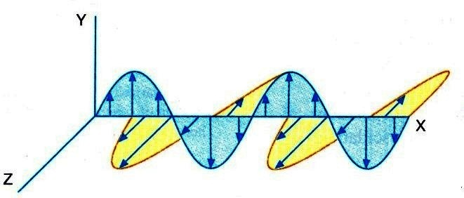
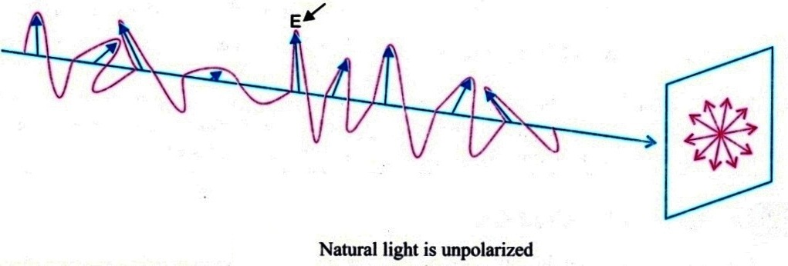



Polarization
The process by which light waves vibrating in different planes can be made to vibrate in a particular plane is called polarization of light.
Ordinary light waves whose vibrations normal to the direction of propagation, spread all around the source with equal amplitude is called unpolarized light.
If the vibration of the waves of light is confined to only one plane, then it is called polarized light.

Slide 4
Polarized light may be produced from unpolarized light using the following five optical phenomena:
Production of Polarized Light
Polarization by reflection
Polarization by refraction
Polarization by scattering
Polarization by selective absorption
Polarization by double refraction

Slide 5
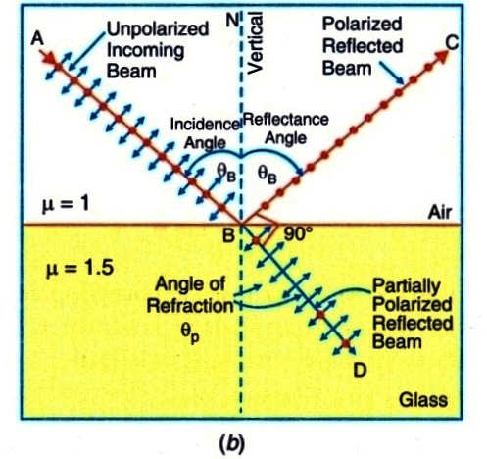
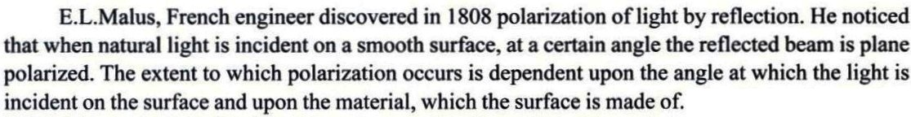
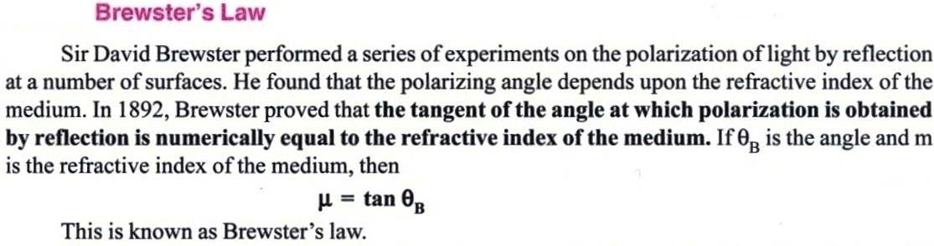
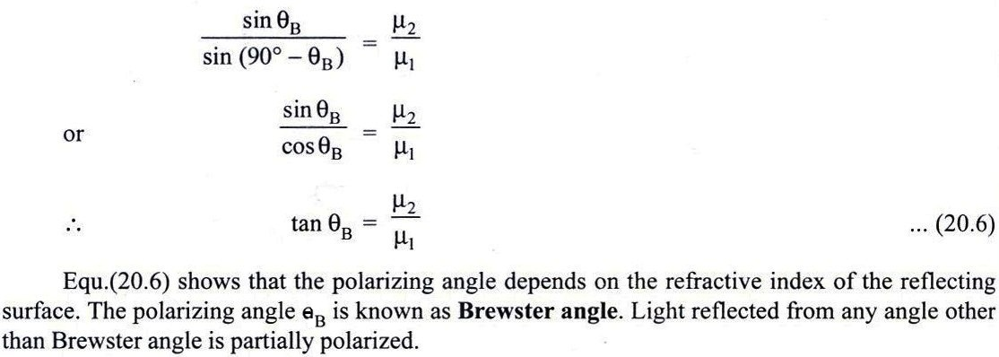
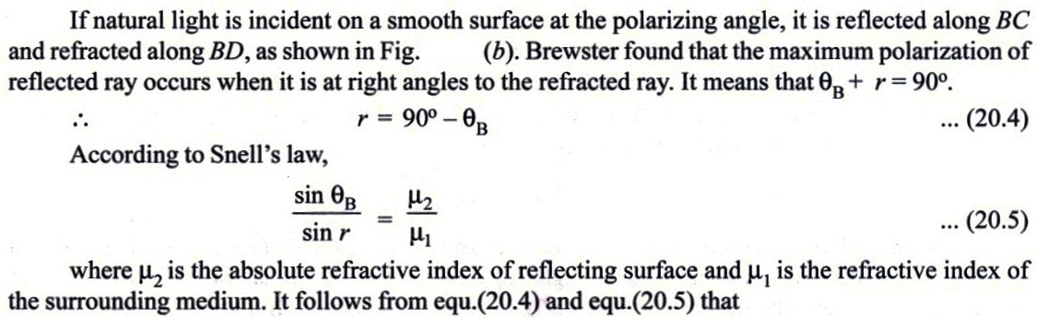
Polarization by reflection and Brewster’s Law
Proof:

Slide 6
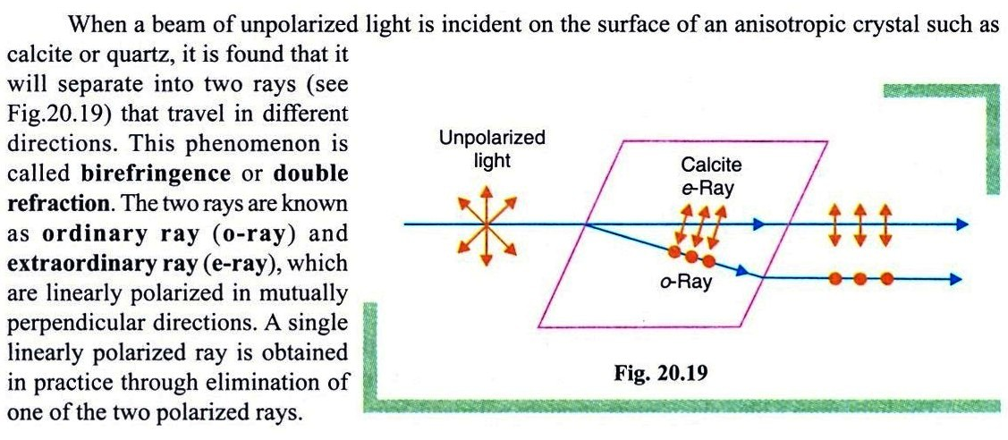
Polarization by double refraction

Slide 7

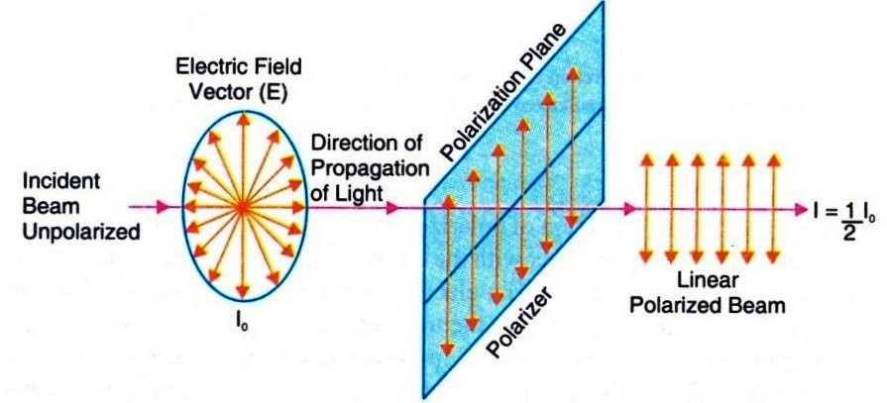

Polarizer and Analyzer
A polarizer is an optical element, which transforms unpolarized light into polarized light
If unpolarized light of intensity I₀ is incident on a polarizer, the intensity of light transmitted through the polarizer is I₀ /2
A analyzer is an optical element, which is used to identify the plane of vibration of polarized light

Slide 8
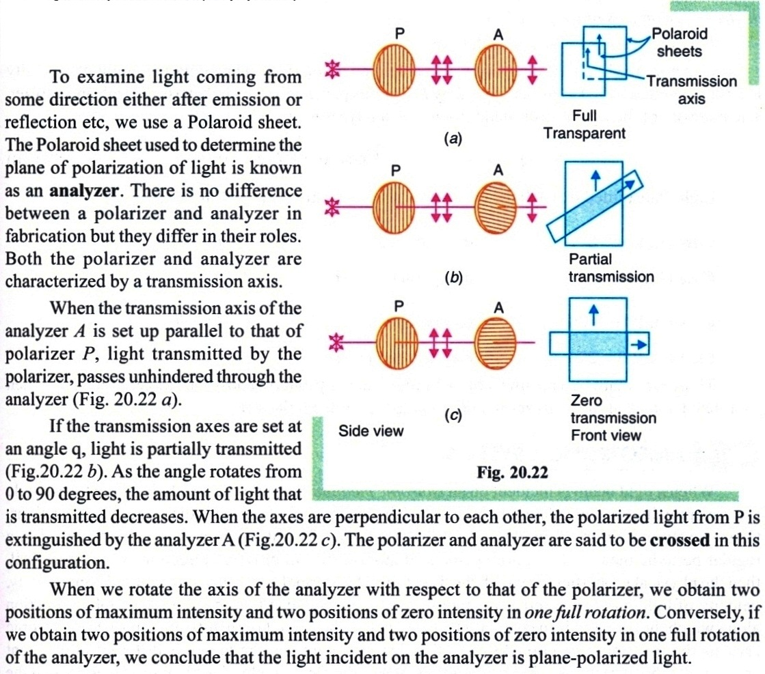
Analysis of Polarized Light

Slide 9
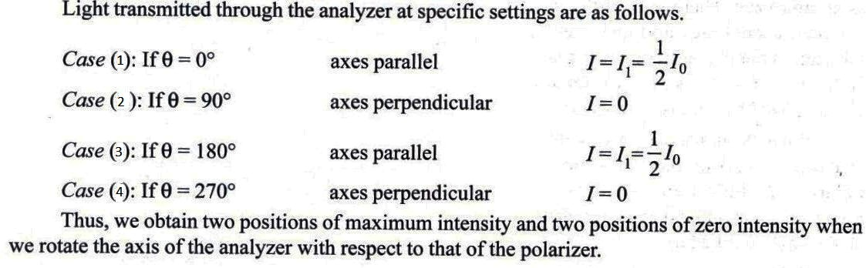
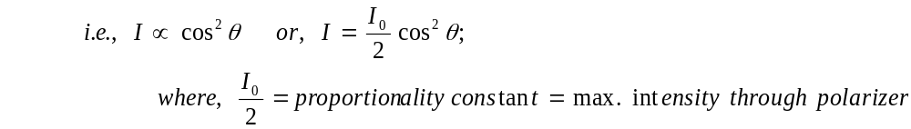
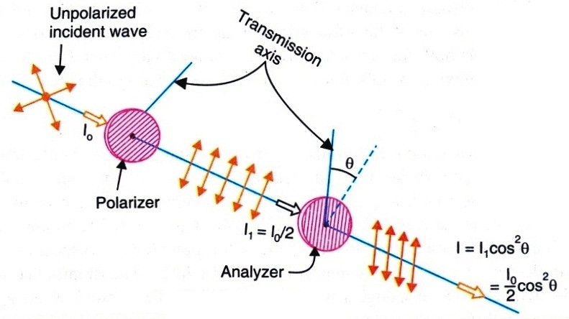
Malus’ Law
The amount of light transmitted through an analyzer at an arbitrary angle is given by Malus’ law. In 1809 Malus found that the intensity of polarized light transmitted through the analyzer is proportional to the square of cosine of the angle between the plane of transmission of the analyzer and the plane of the polarizer.

Slide 10


